Slide 1
eCONSPICUITY
Groundstations
Belgian Project
BULMF AG/AV 9.3.2024

Slide 2
Making Airtraffic visible to pilots
Installing 21 ground stations in Belgium to cover whole Belgian Aispace
In cooperation with

Slide 3
Teaser : Limits of ‘See and Avoid’
Questions ….
Who has encountered a ‘near miss’?
Who has reported this incident?
Who has been surprised by another aircraft close in the air?
Who has Radio on board?
Who has transponder on board? ADS-B?
What does FIS Brussels Info ‘SEE’? Did FIS Brussels inform you about conflicting traffic?
Who has a ‘system’ on board to help you better ‘See and Avoid’?
We ‘SEE’ little traffic…
If we do not make us ‘visible’, other pilots do not ‘SEE’ us… Limitations of “See and Avoid” in VFR : HELP TECHNOLOGY PLEASE ! https://www.safesky.app/en/post/what-the-eye-doesn-t-see-the-heart-doesn-t-grieve-over

Slide 4
Motivation
For SAFETY - Be responsible Reduce the risk of collision in flight:
Below 5000 feet
In the vicinity of aerodromes/airfields
On touristical spots or coastal places
High-density non-controlled airspaces
2. For the new challenge : DRONES
Let’s share the airspace
By being VISIBLE to each other
By avoiding each other in an efficient way
3. LOOK OUT + use technology to assist you

Slide 5
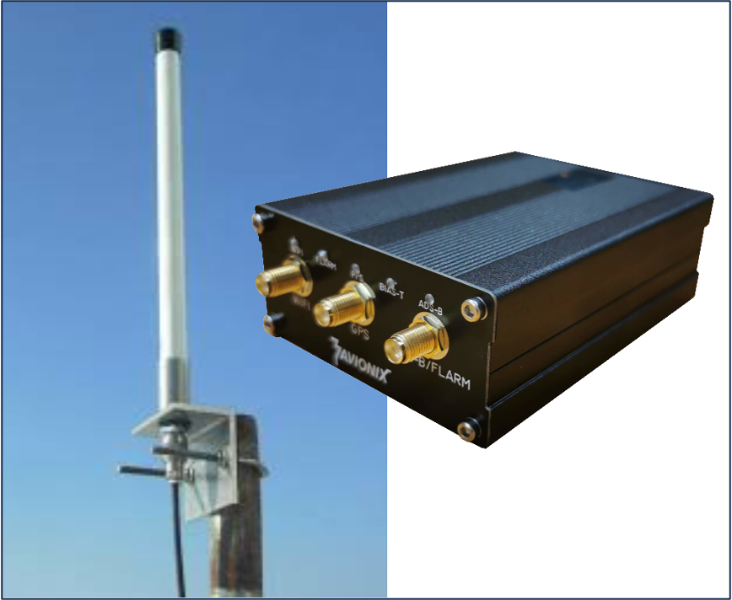
Ground Stations : WHY?
Existing commercial networks (FR24,ADSBExchange) :
Expensive, not visible for pilots in the air
Other networks:
not covering whole Belgium, only part of traffic,
Our Skeyes do not want/cannot make available their traffic data
Own stations :
collect all signals : ADS-B, Flarm, Fanet, Mod S…
send all this traffic to cooperative network
In line with EASA policies ‘ Conspicuity’
Making traffic visible in S E R A 6005,c https://www.easa.europa.eu/community/system/files/2023-11/GA%20Community%20-
%20GA.COMM%20and%20GA.TeB%20meeting%2002-2023.pdf

Slide 6
Objectives ?
Collect all signals via ground stations
2. Assemble with all other available data
from other collaborating ground station networks (OGN…)
from other devices/software used by pilots
3. Making all data available for
Open Glider Network – SafeSky
EasyVFR - AirNavPro
Collaborative devices: Skytraxx, Syride, Flymaster …
Collaborative Software: Gaggle, XCTrack, eVario,
4. Sending all data/picture to pilots in the air
GAGGLE

Slide 7
Similar projects in Europe
Spain :
Installation of ground receivers/antennas on 45 airfields
Collaboration : ENAIRE -AESA-RACE-AOPA-AEPAL, financed by Authorities.
https://www.enaire.es/es_ES/2023_07_13/ndp_convenio_enaire_seguridad_operacional https://www.boe.es/diario_boe/txt.php?id=BOE-A-2023-20100
Norway :
Norwegian Air Ambulance (“Norsk Luftambulanse” HEMS) en partenariat avec SafeSky and AVIONIX : 100 ground receivers/antennas
https://www.safesky.app/en/post/norway-takes-the-lead-in-air-safety-with-a-triple-partnership-involving-safesky
Individual similar actions :
France (Colmar, Reims), Germany, Danmark and RU
Same receivers/antennes used : AVIONIX

Slide 8
How? Installing receivers/antennas
State-of-the-Art - ‘Plug In’ - Affordable
Covering the entire Belgian Airspace
Receiving all signals
ADS-B, Flarm, Fanet
MLAT for Mode S
(some : Remote ID for drones)
In collaboration with :
https://avionix.eu/solutions/openair-multitrack/

Slide 9
State of play 9.03.2024
21 stations delivered – 14 installed
Evaluation starts in April 2024
Added value – coverage of whole Belgian Airspace – ‘white spots’ – technical problems..
Data sent to OGN and SafeSky
Much more traffic is visible on SafeSky !
https://live.safesky.app/map

Slide 10
State of play 9.03.2024
Map with active stations in Belgium +
Traffic captured by these stations :
https://Aero-network.com/map
Total picture of all trafic : see on SafeSky.app
Participating Clubs :
EBFN Koksijde - EBUL Ursel - EBOS Oostende - EBGB Grimbergen - EBTY Baisy Thy - EBST Sint Truiden - EBAR Arlon - EBZH Kiewit - EBAV Avernas - EBGG Geraardsbergen - EBSG Mons - EBBT Brasschaat - EBDT Diest - EBZR Zoersel - EBBN Bullingen - EBSP Spa - EBSH Saint Hubert - EBWE Weelde - EBLE Leopoldsburg - EBML Maillen - EBMO Moorsele - EBZH Kiewit – EBTX Verviers
Thanks to all !

Slide 11
What will pilots ‘SEE’ in the air ?
All trafic that is ‘Visible’ :
1. Via our own network of ground stations
2. Via cooperative networks of ground stations : 3. SafeSKy users (65.000 in EU)
4. users of collaborative devices and software
- EasyVFR, AirNavPro, XC-Track, eVario, … - Gaggle, SKYTRAXX, Syride, Flymaster …
Visible on the cooperating devices and software
Aircraft / pilots that do not transmit remain INVISIBLE
➔ Other actions will be needed to convince all pilots to become ‘Visible’

Slide 12
Will we ‘SEE’ all the traffic in the air by this project ?
➔ NO
Aircraft / pilots that do not transmit remain INVISIBLE
➔ Other actions will be needed to convince all pilots to become ‘Visible’

Slide 13
Let’s be VISIBLE - eCONSPICUOUS
By all existing means : - ADS-B, Transponder Mode S, Flarm - using EasyVFR/AirnavPro with SafeSky embedded - other cooperative devices/software
or by SafeSky : it’s free - anonymous – Just culture
Use it cleverly : it is just a help, but a precious one Be aware of the limitations (battery – internetconnection)
LOOK OUT + use technology to assist you. It gives you an extra pair of eyes

Slide 14
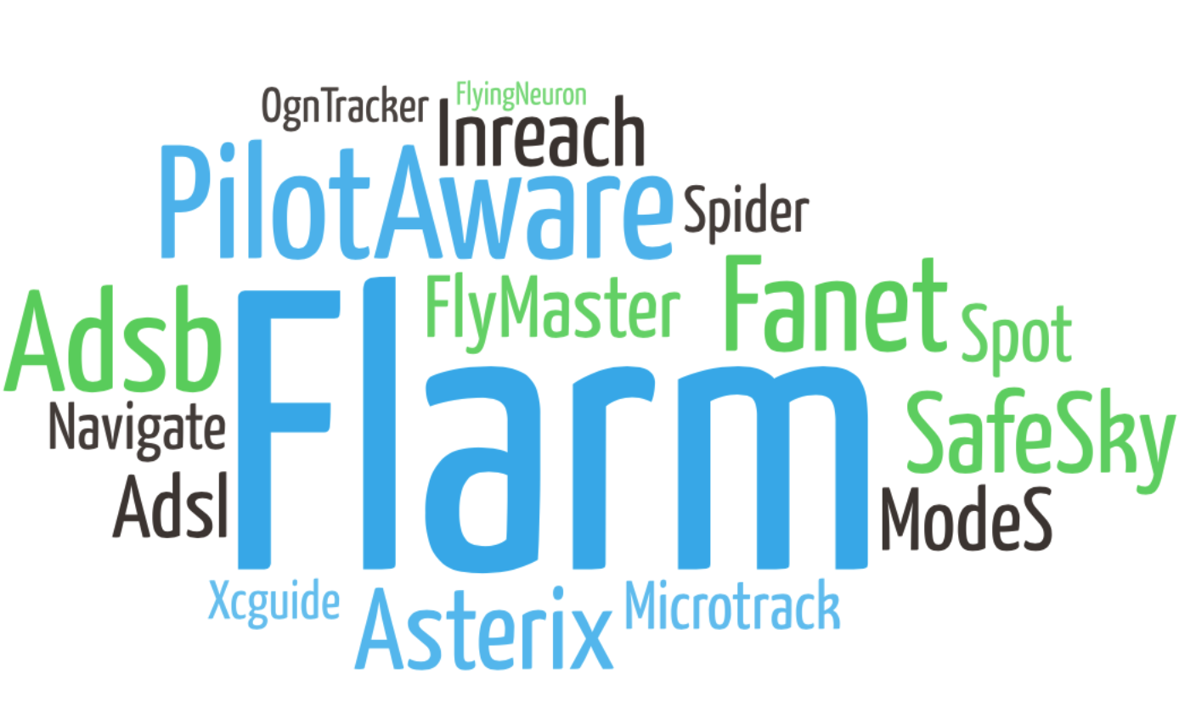
Interoperability
15 traffic protocols from ground stations:
Collaborative traffic
Integrated into many Apps and Hardwares:
Free flight: Gaggle, eVario, XCTrack, theFlightVario, SkyTraxx, Air3, Flymaster
Drones: Aviant, SkeyDrone, Helicus
Navigation Software: EasyVFR - AirNavPro
eConspicious hardware: SkyEcho, PilotAware, PowerFLARM, Stratux

